Slide 1
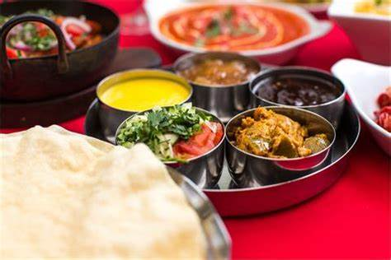
Curry & Quiz
Winter Sizzling Fundraiser
supporting free professional theatre for children
Balti House
24 Commercial Road, Weymouth, DT4 7DW
Organise own table of six or we add you to a table
Curry, Quiz, Entertainment, and Raffle
Wednesday 1 November
6:30 – 9:30 p.m.
Tickets £22.00 all inclusive
Booking essential – call: 01305835541
or email info@as-onetheatre.co.uk

